Slide 1
GitFlow

Slide 2

Objective of Presentation
You should be able to:
Describe GitFlow
Conceptualize GitFlow branching strategy
Understand best practices for developer workflow
Implement GitFlow with GitKraken
Understand basic workflow and features of GitKraken
Note: master/main and develop/staging are used interchangeably.

Slide 3
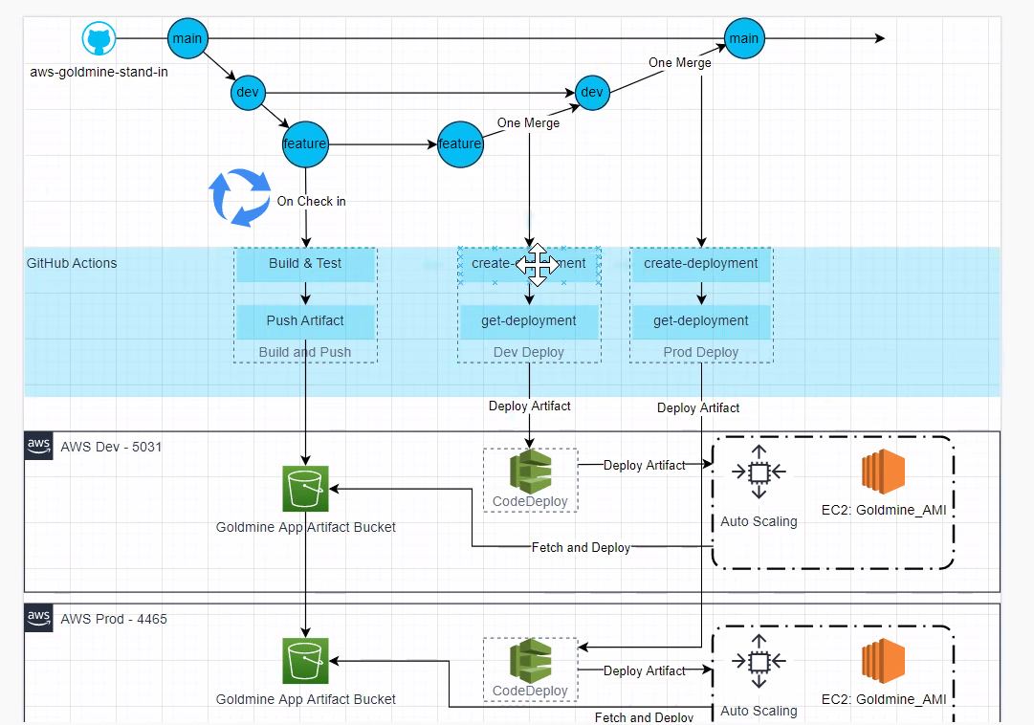
What is GitFlow
Not to be confused with GitFlow CLI
Abstract Branching model
Meant to support a release cycle with multiple contributors
Considered a DevOps CI/CD Best Practice
Works OOTB with DevOps (CodeDeploy) process being built by CloudMission

Slide 4

Why GitFlow?
Easy to understand
Easy to implement
Creates audit trail of development process
Supported by modern day CI/CD platforms
Less noise for the developer
Better oversight for project management

Slide 5
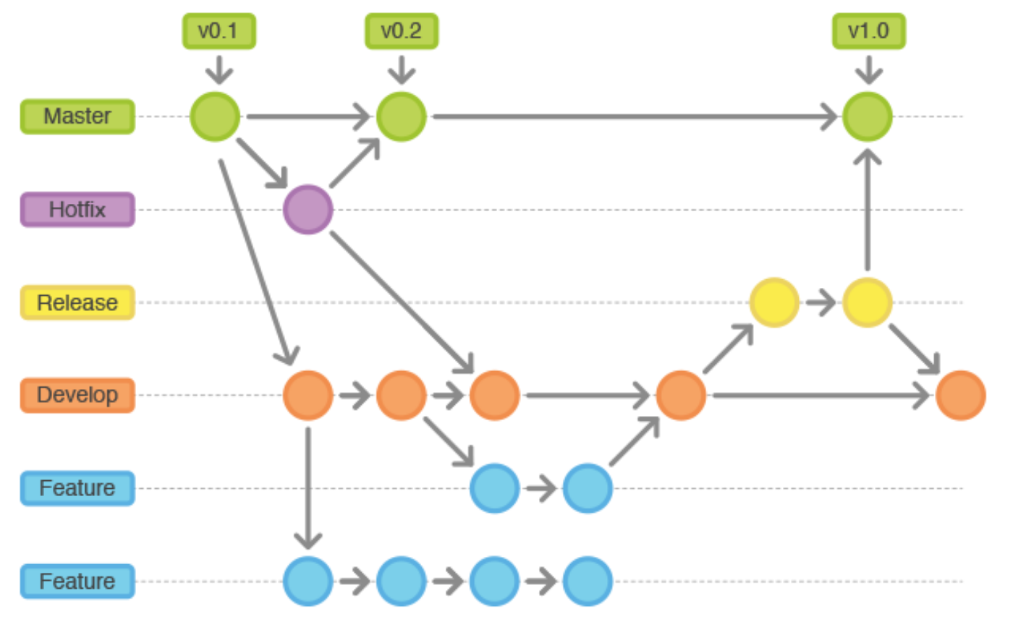
GitFlow Branches
GitFlow has 2 primary branches
Is parent (BASE ref) for all other branches
master (main)
develop (staging; default)
Additionally, GitFlow has branch prefixes for different functions
hotfix/
feature/
release/
You can think of each branch prefix as a folder

Slide 6
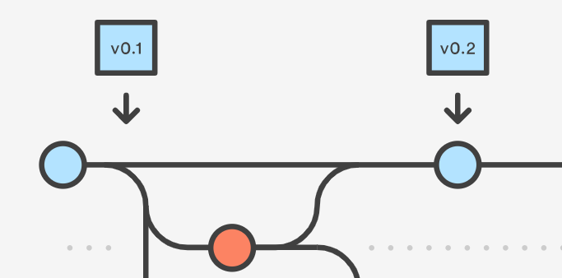
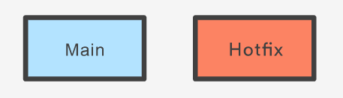
hotfix/
Only branch prefix that will branch directly from main (BASE ref)
Used to deploy hot fixes between release
In GitKraken releases should be tagged to ensure proper merging
Merges into staging and main

Slide 7
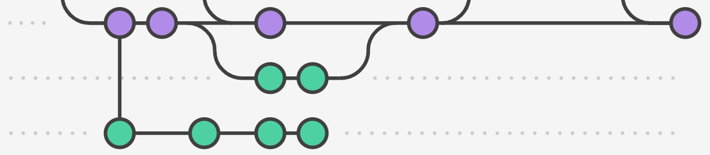
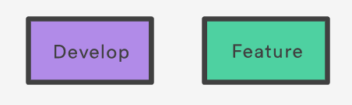
feature/
Contains all scheduled release items
Features
Bugs
Config
BASE ref will be staging
Merged back into staging

Slide 8
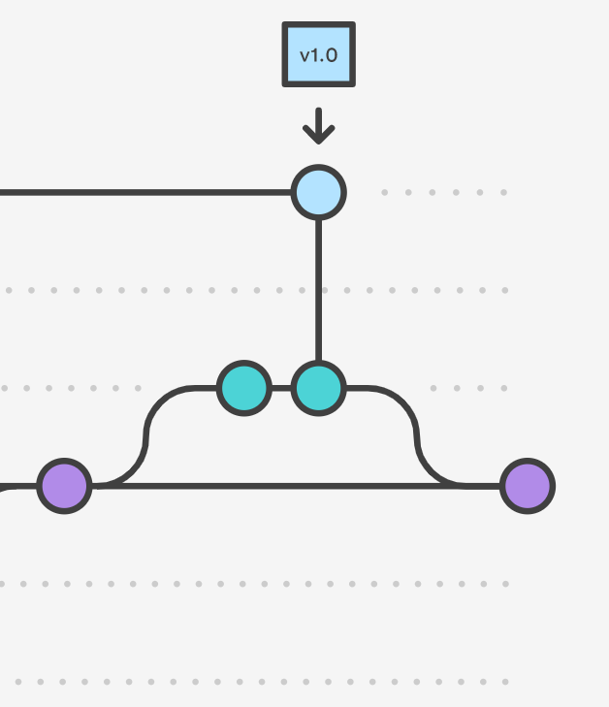
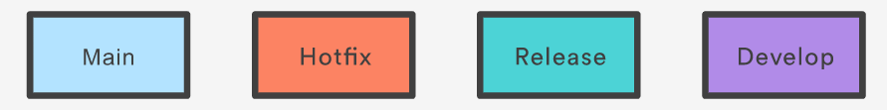
release/
Used to merge staging into the master branch
Useful for last minute configuration, testing, and maintenance of release notes.
The BASE ref will be staging
Merged into master

Slide 9
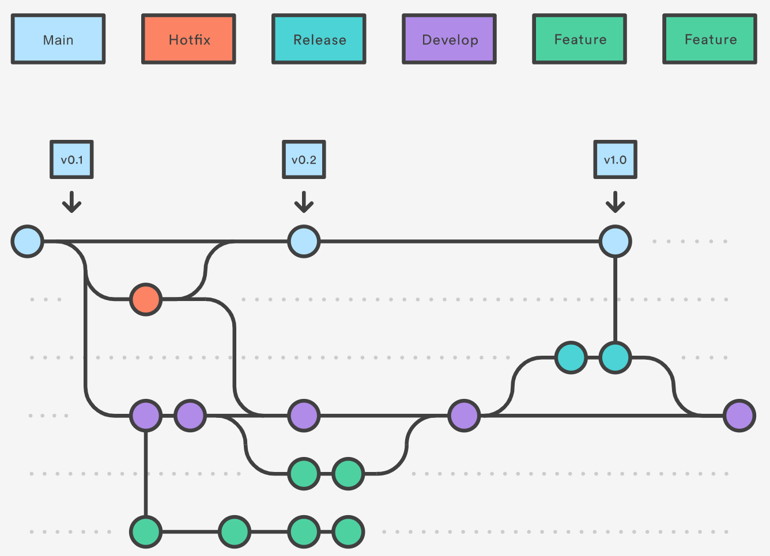
Putting it all together

Slide 10
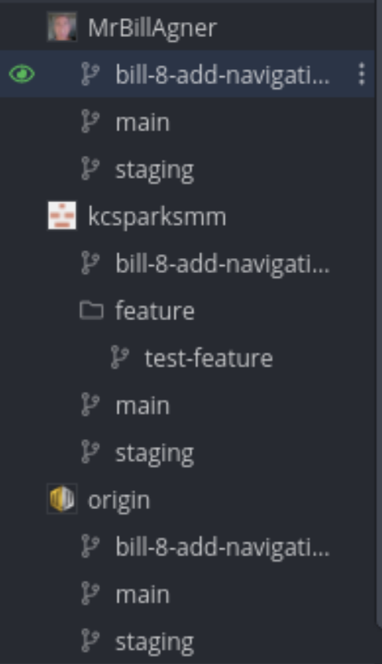
Remotes
As team grows feature branches on origin will become hard to navigate
Solution: Each developer creates a fork and maintains ownership (remote)
Pull requests will be made from remote to origin
Rebase, pull, and fast forward operations will allow you to sync with origin staging/main
Remote branches are deleted once feature is merged

Slide 11

[ADMIN] Remotes
When a developer’s access is revoked all remotes owned by that user are deleted.
Before removing a user be sure to push all of the remote feature branches to origin
Sometimes this operation can result in a disconnected commit tree, this can be resolved by rebasing the branch on the appropriate BASE ref
These feature branches can be reassigned and moved to another developer’s fork

Slide 12
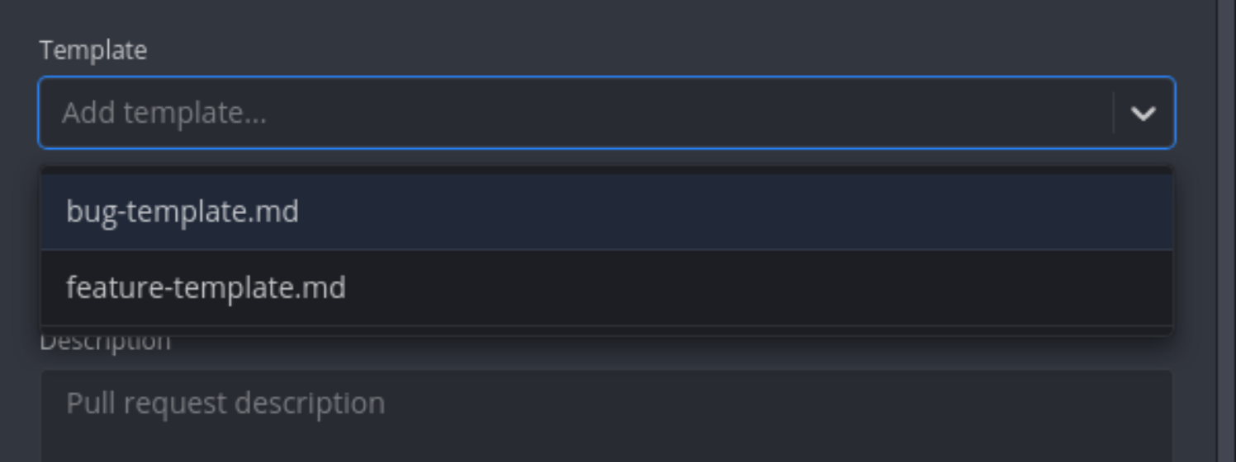
Pull Request
PR Templates can be added to GitKraken to speed up process.
Automate PR/Issue linking by using built-in keywords.
No commits should ever be made directly to main/staging
Merge conflicts are handled on a first come first serve basis
Use interactive rebase to clean up your commits before opening a PR
Templates can be added to /.github/PULL_REQUEST_TEMPLATE/<name>-template.md
PR Linking Doc: https://docs.github.com/en/issues/tracking-your-work-with-issues/linking-a-pull-request-to-an-issue

Slide 13
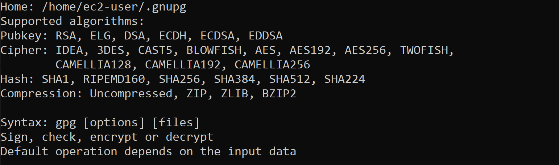
GPG Signing
Verifies author identity
Can be enforced by GitHub
Easy to setup with GitKraken
Secures development process as it grows

Slide 14
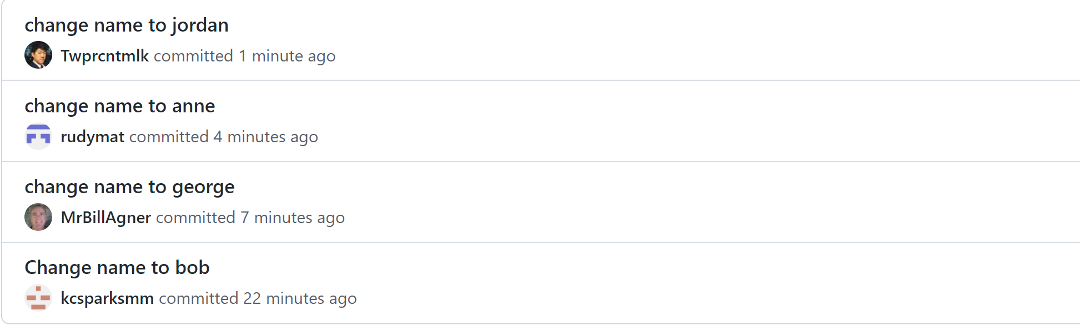
A Tale of a Rogue Developer
Commits made by one author
Still pulls in profile picture
Hard to discern if the commit is not forged
Easy to change profiles with .gitconfig

Slide 15
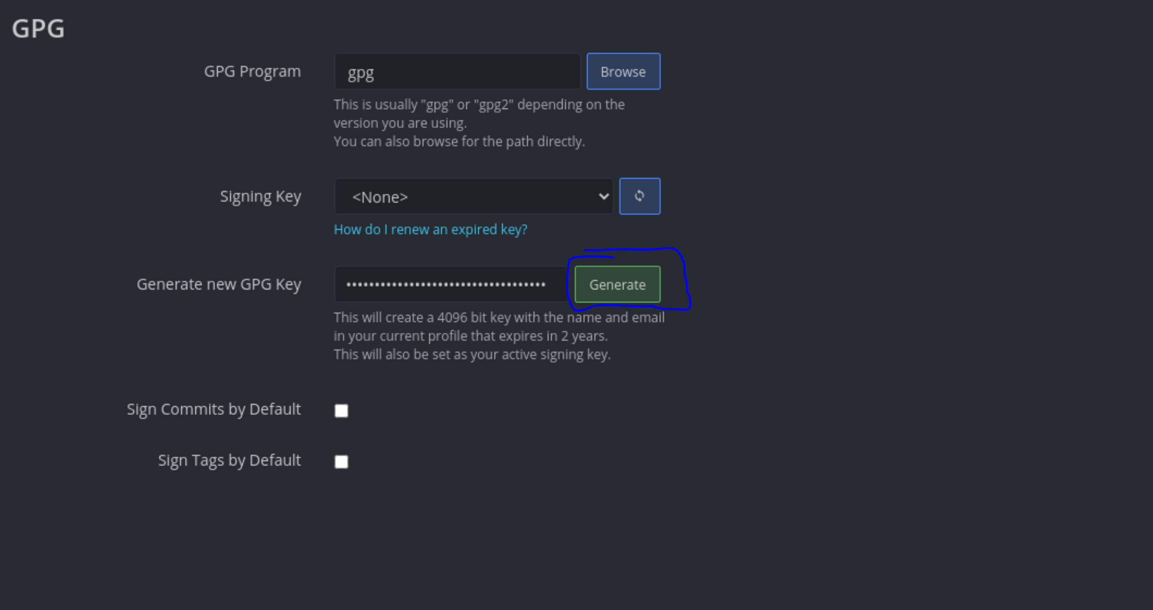
Generate a Password Protected Key

Slide 16
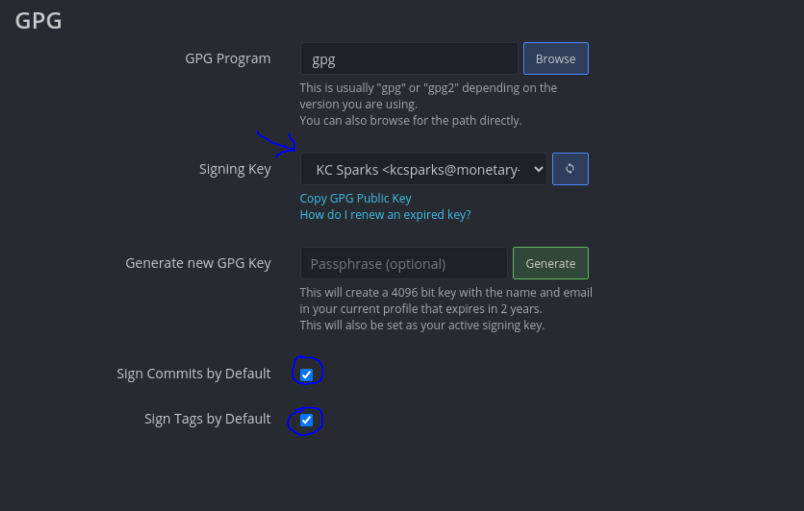
Set Options
Select Signing Key
Select Sign Commits by Default
Select Sign Tags by Default

Slide 17
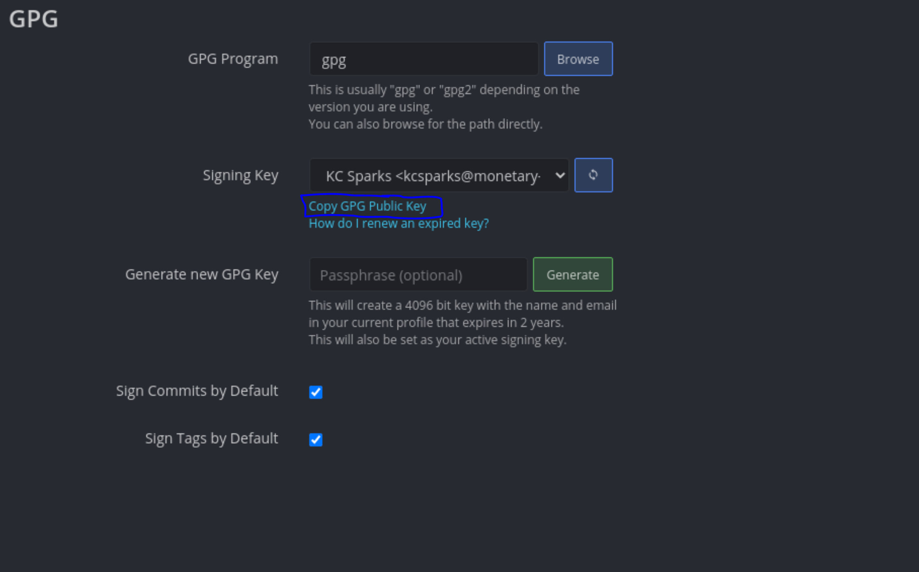
Add GPG Public Key to GitHub
Copy Public Key
Add to github.com settings

Slide 18
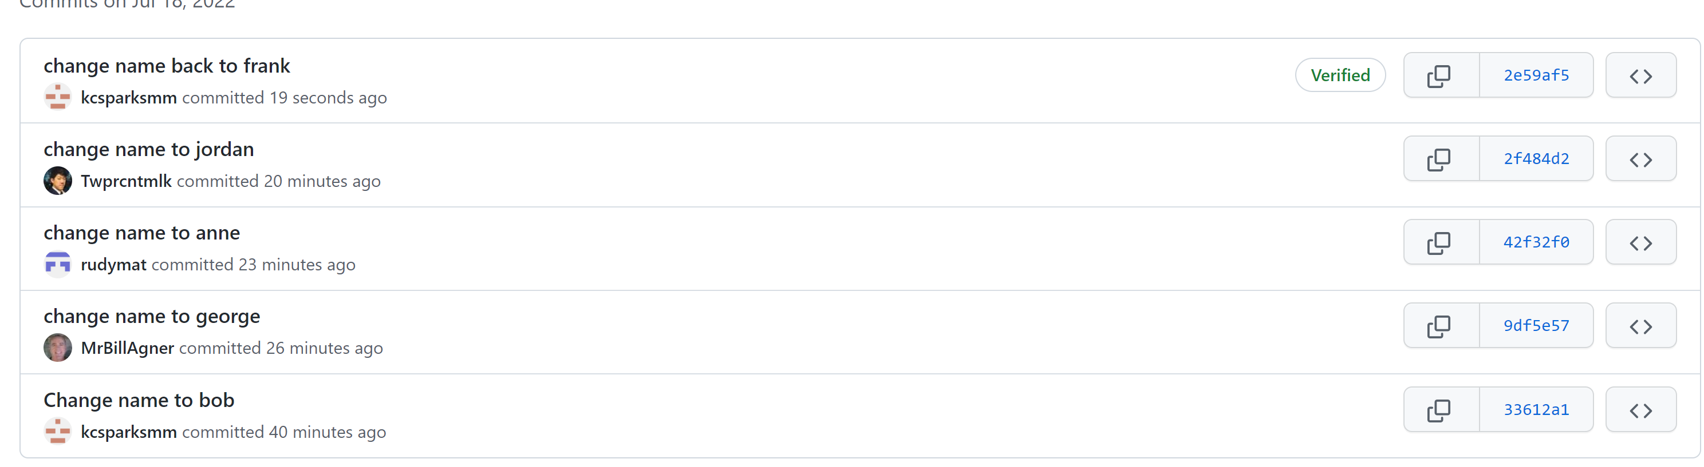
Commits Are Verified

Slide 19
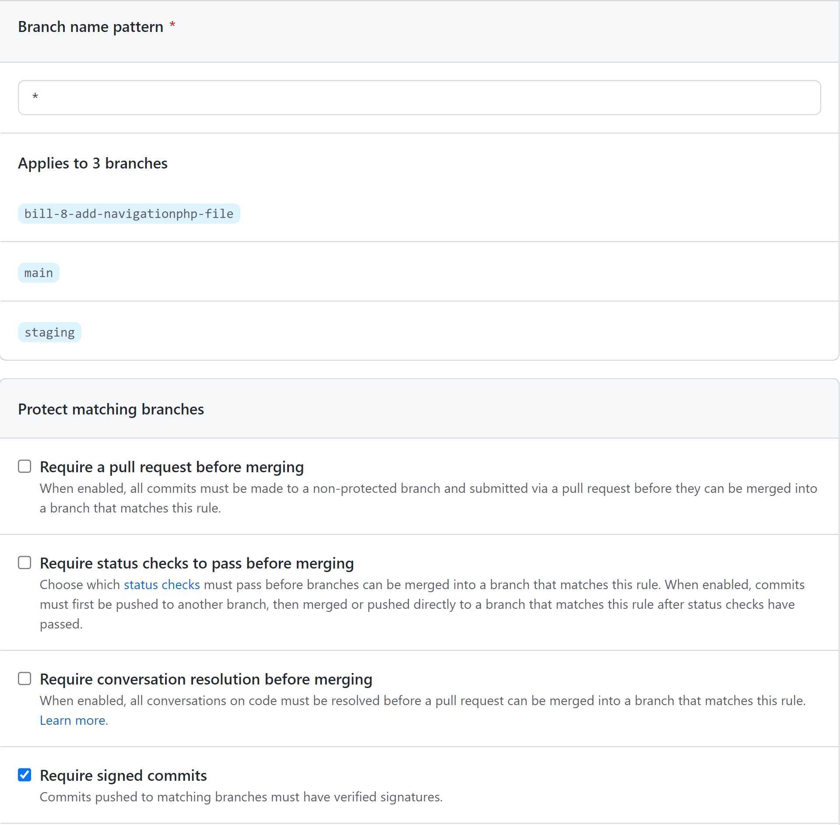
[ADMIN] Enforce GPG Signing
Add branch protection
Pattern is *
Require signed commits enabled

Slide 20
[ADMIN] Branch Protection
*
Require signed commits
Main/staging
Require a pull request before merging
Require approvals
Dismiss stale pull request approvals when new commits are pushed
Require status checks to pass before merging
Require branches to be up to date before merging
(GM will fail this requirement in its current state)
Require conversation resolution before merging
Require linear history (discuss)
Enable squash merging

Slide 21
Git Best Practices (Review)
Never directly commit to staging or main
GPG sign every commit
Use appropriate branch prefix
Don’t make any changes to another developer’s remote without permission
Rebase and clean up commits before creating PR
Merge via PR
Resolve conflicts if another PR creates a merge conflict

Slide 22
GitKraken Demo/Documentation
WSL 2 Installation
VcXsrv Link
Commit
Push and Pull
Stash
Checkout
Branching and Merging
Rebase
Interactive Rebase
Handle merge conflicts
Forks
Configure GitFlow
Add SSH Key
Create PR

